Slide 1


Sardar Vallabhbhai National Institute of Technology , Surat - 395007
A
Project Presnetaion
Entitled
Flood Management & Water Quality Measurement using 5G IoT
Guided by,
Dr. (Ms.) Shilpi Gupta
(Associate Professor, DoECE)
Co-Guided by,
Dr. Raghavendra Pal
(Assistant Professor, DoECE)
Presentated by,
Kalpesh Parmar (U21EC103)
Aayush Parikh (U21EC126)
Mihir Solanki (U21EC161)

Slide 2
Flood Management and Water Quality Measurement using 5G-IoT
Objective: To address flood risks and water quality concerns by continuously monitoring key environmental metrics.
Technologies Used: Utilizes IoT sensors and 5G technology for fast, real-time data transmission and monitoring.
Key Metrics: Monitors water levels, pH, turbidity, TDS, and rainfall intensity to assess flood risk and water quality.
Target Outcomes: Aims to improve disaster preparedness and efficient resource management through real-time monitoring.

Slide 3
Working and Process Flow
Data Collection: Sensors measure water levels, rainfall, pH, turbidity, and TDS in real time.
Data Transmission: Collected data is sent to the Bharat Pi module using 5G for fast and reliable connectivity.
Edge Computing: Local processing of data minimizes latency and enables immediate analysis
Cloud Integration: Processed data is uploaded to the cloud for storage and visualization.
Decision Support System: Insights from the processed data assist in effective planning and response strategies during floods or water quality issues.

Slide 4

System Components
Bharat Pi 4G LTE Module for connectivity:Provides reliable internet connectivity for remote data transmission via 4G LTE.
Ultrasonic Sensor for water level detection: Measures water levels in real-time to predict flood risks.
Raindrop Sensor for precipitation monitoring: Detects rainfall intensity to aid in flood prediction and monitoring.
pH and Turbidity and TDS Sensors for water quality analysis: Measures the pH and turbidity levels of water to assess its cleanliness and safety.
Cloud platform for data storage and visualization: Stores and visualizes the data for analysis and decision-making.

Slide 5
Achievements and Future Scope
Real-time monitoring capabilities for floods and water quality: Provides instant data on water levels and quality to aid decision-making.
Scalable and modular architecture: The system can be expanded to include more sensors and regions as needed.
Renewable energy integration for remote setups: Future systems may use solar or wind power to operate sensors in off-grid locations.
Potential for integration with smart city infrastructure: The system can be integrated with smart city networks for enhanced disaster management and resource monitoring.
Support for Sustainable Development Goals (SDGs): Contributes to SDGs by promoting sustainable water use and environmental protection

Slide 6
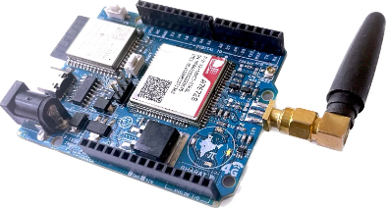
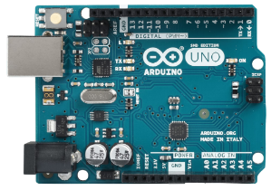
Bharat Pi: An Evolution in Microcontrollers
Bharat Pi
Arduino Uno
Microcontroller: 32-bit Dual Core, 160 MHz (10 times faster than Arduino Uno)
Microcontroller: 8-bit Single Core, 16 MHz.
RAM: 2 KB.
RAM: 512 KB (256x more memory space).
Flash Memory: 32 KB.
Flash Memory: 16 MB (can handle larger codebases, such as 1000+ lines of code).
Network: No built-in connectivity (requires external modules for Wi-Fi or Bluetooth).
Network: Built-in Wi-Fi and Bluetooth for internet connectivity.
GPIO Pins: 14 General Purpose I/Os.
GPIO Pins: 36 General Purpose I/Os (can connect 2.5x more sensors).
Bus Interfaces: SPI, I2C, UART.
Bus Interfaces: SPI, I2C, 2xUART, I2S, CAN (more UART and CAN interface options).
ADC Channels: 6 Analog-to-Digital Converters.
ADC Channels: 18 Analog-to-Digital Converters (can connect 3x more analog sensors).
Data Storage: No SD card support.
Data Storage: Supports an SD Card up to 128 GB (ideal for AI/ML edge data mining).

Slide 7
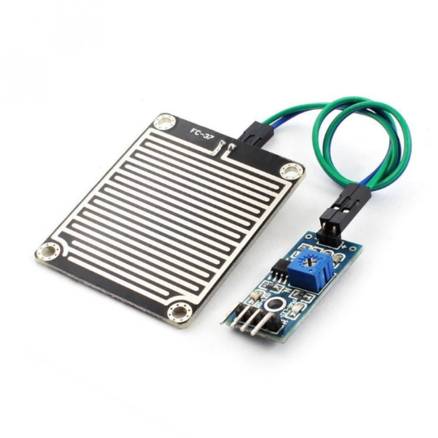
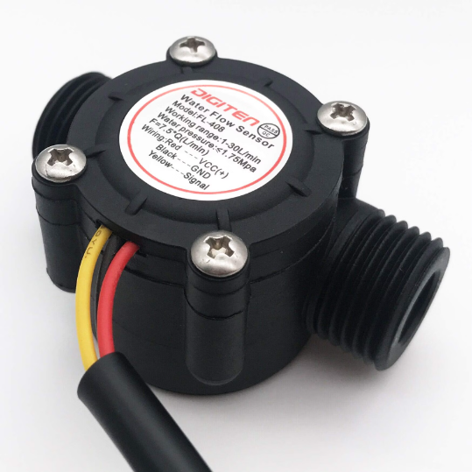
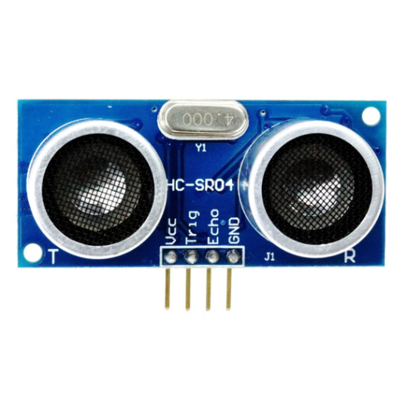
Flood Management
Rain Sensor
Water Flow Sensor (YF-S201)
Ultrasonic Sensor (HC-SR04)
3Detects rainfall effectively using changes in conductivity due to water.
Measures water flow accurately for discharge monitoring using rotational pulse-based measurement.
Measures water level accurately and cost-effectively using ultrasonic wave reflection.

Slide 8
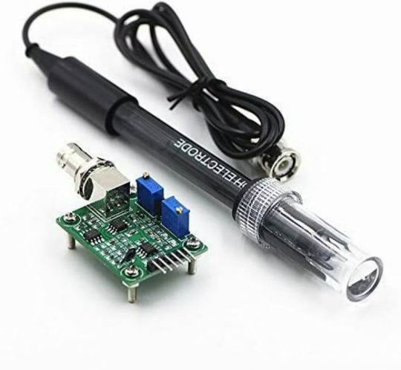
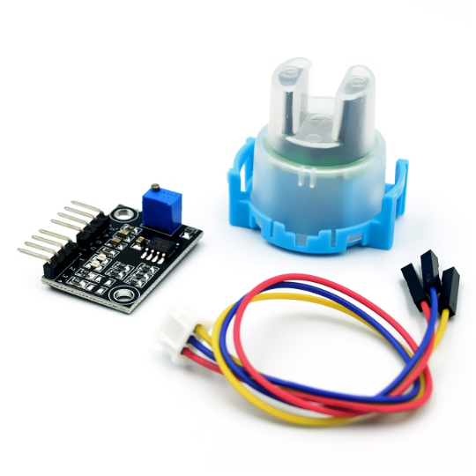
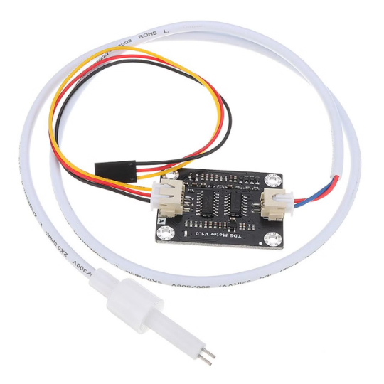
WaterQuality Measurement
pH Sensor
Turbidity Sensor
Total Dissolved Solid
Monitors water acidity or alkalinity through hydrogen ion concentration, a crucial parameter for water quality.
Measures water cloudiness effectively for sedimentation monitoring by detecting optical suspended particles.
The TDS Sensor measures total dissolved solids in water using electrical conductivity, providing an indication of water purity.

Slide 9
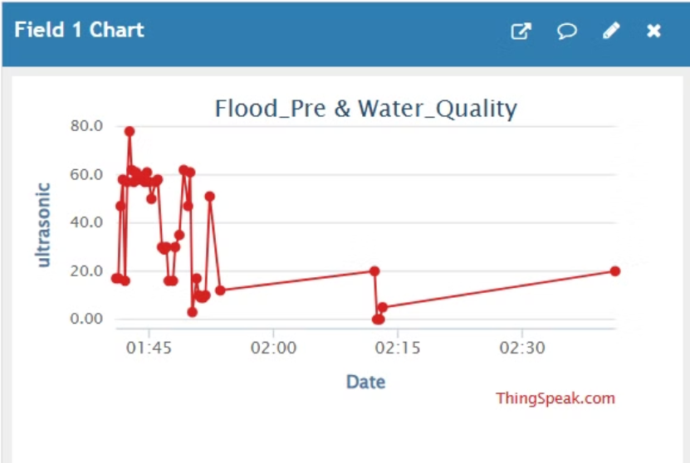
Data Analysis
We use ThingSpeak and a custom-built website to collect, visualize, and analyze real-time sensor data. This platform allows us to monitor water parameters through interactive graphs for better flood management and water quality assessment.
• Water Level (Ultrasonic Sensor HC-SR04):– We can collect data in real-time to monitor the water level in reservoirs, rivers, or lakes.– Example: Sudden spikes in water levels could indicate the risk of flooding.– Measurement units: centimeters (cm) or meters (m) now made same for water flow sensor

Slide 10
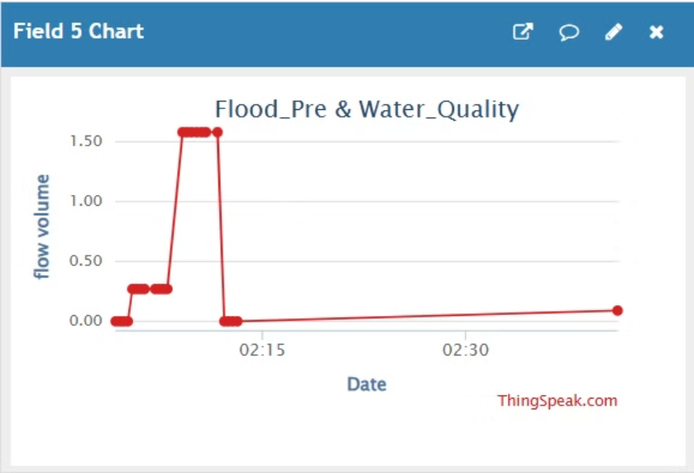
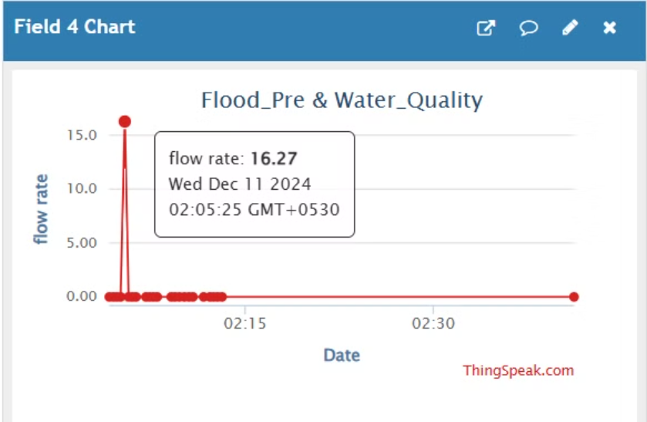
Data Analysis
Water Flow (YF-S201 Sensor): Real-time data monitors water flow in pipelines, rivers, or irrigation systems, with sudden increases indicating pipe bursts or flooding, and reduced flow signaling blockages or drought conditions. Measurement units: L/min or m³/h.
The total volume of water is calculated by integrating the flow rate data over time and displayed on a graph.
Real-time data from the water flow sensor is used to plot the speed of water passing through the sensor over time.

Slide 11
01
Issues Faced During Component Procurement and Integration
02
Constraints in Data Accuracy & Connectivity
Challenges
&
Limitations
03
Enhancing Sensor Coverage and Accuracy
04
Scaling the System for Large Geographical Areas

Slide 12
Issues Faced During Component Procurement and Integration
01
Availability of Components
Cost Constraints
Component Compatibility
Power Supply Integration

Slide 13
Constraints in Data Accuracy & Connectivity
02
Sensor Accuracy
Environmental Factors
Data Latency

Slide 14
Enhancing Sensor Coverage and Accuracy
03
Expanded Sensor Deployment
Improved Sensor Technology
Integration of Advanced Communication Protocols

Slide 15
Scaling the System for Large Geographical Areas
04
Distributed Architecture
Interconnected Network of Systems
Integration with Smart City Infrastructure

Slide 16
*
Conclusion
*
*
*
Advanced Monitoring Capabilities
Scalability and Flexibility
Energy Efficiency and Sustainability
Proactive Disaster Management
Support for Sustainable Development Goals (SDGs)
Improved Water Quality Management

Slide 17
Thank you

Slide 18
Questions
&
Answers

